Slide 1
Formula SAE Lincoln
Dynamic Events Drivers Meeting
Acceleration, Skid Pad, Autocross, Endurance
06.22.2017

Slide 2
General Announcements
Hot Areas (appropriate behavior and attire)
Closed-toe shoes
Preferably long pants, however shorts are allowed due to hot weather
No Running
Number of team members allowed in Hot Area
4 with dynamic passes (5 for EV teams)
How to identify Event Captains?
PINK Safety Vests
Weather
Track condition/tire requirements
Emergency locations / listen for announcements

Slide 3
WEATHER and TIRES
Track Weather Condition | Tire Type
 | Dry | Rain
Dry
Damp
Wet

Slide 4
GENERAL SAFETY
Event captains are wearing PINK Safety Vests – find us if any problems or questions
Dress/other ID for SCCA volunteers
Data Logging locations (endurance only)
See Lawrence or Jacob if have data beacons for specific locations to set up
Must be set up and retrieved before/after heats only

Slide 5
PHOTOGRAPHERS
No photographers allowed on course during dynamic events
Credential media will be escorted by SAE staff or volunteers

Slide 6
BE PREPARED: CHECK THE RULES
All teams are responsible for reading and comprehending the rules prior to competition
If you do not understand one of the rules or have questions, find the event Captain before the event starts
Foreign Teams and Teams with non-English Speaking Members
Please ensure prior to Friday/Saturday that all drivers understand the dynamic-area rules, flags, and procedures
Teams with drivers who do not speak English must provide a translator who has to stand near race control while the driver is on course
The Event Captains have final discretion

Slide 7

SCCA SAFETY
Safety Steward: Howard Duncan
Co-Steward: Clancy Schmidt

Slide 8

SCCA FLAGS
SCCA Flags for Acceleration
GREEN -- Enter the course under direction of the starter.
CHECKER -- Your session has been completed
SCCA Flags for Autocross
GREEN -- Enter the course under direction of the starter.
RED -- Come to an immediate safe controlled stop on the course. Follow worker directions.

Slide 9
SCCA FLAGS FOR ENDURANCE
GREEN -- Your session has started, enter the course under direction of the starter.
BLACK -- Pull into the penalty box for discussion with the Chief Marshall/Director of Operations or other official concerning an incident
YELLOW -- Danger, SLOW DOWN, be prepared to take evasive action, NO PASSING unless directed by the corner workers.
MECHANICAL BLACK -- Pull into the penalty box for a mechanical inspection of your car
RED -- Come to an immediate safe controlled stop on the course
CHECKER -- Your session has been completed
BLUE -- Pull into the designated passing zone to be passed by a faster competitor.

Slide 10
COURSE WALK SCHEDULE
COURSE IS DEFINED BY CONES, NOT CHALK
All Dynamic Events open for walking 2pm Thursday.
It is responsibility of team to make sure to walk the courses before the event takes place
Listen to announcements for any changes

Slide 11
ACCELERATION
Friday 8:00am – 11:30am
Captain: Tim Gornik

Slide 12
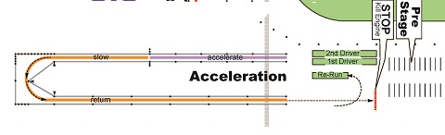
ACCELERATION LAYOUT

Slide 13
ACCELERATION EVENT course = 75 meters
2 drivers per team, 2 runs each
Three Staging Lanes - Priority Order - Re-Run, First Driver, Second Driver
Event Flow
Team may use Pre Stage area
Enter Staging Lanes ONLY when car is ready to run!
Staging Lanes are under Event Control and for confirming Safety Equipment
Event Worker will call Car to Start Line – STOP AT START LINE!!!
Green Flag gives Permission to Start - Timing starts when timing beacon Is triggered
Double Cones at Finish Line / Checkered Flag
Brake – Turn – Repeat
Driver can take second run immediately or exit into Pre Stage
Ends at 11:30pm

Slide 14
ACCELERATION SCORING
Cone down and out = 2 second penalty
Any cone hit counts as penalty INCLUDING cones in run off area/return lane
Off course = a DNF for that run – no rerun
Failure to Observe Event Procedures can result in loss of fastest run time

Slide 15
SKID PAD
Friday 8:00am – 11:30am
Captain: Joe Losito

Slide 16
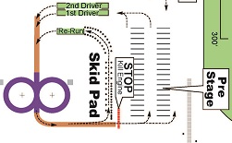
SKID PAD LAYOUT

Slide 17
SKID PAD EVENT
2 drivers per team, 2 runs each
First drivers are prioritized over Second drivers
Ends at 11:30 sharp
Flow of Event
Team pushes car into appropriate Driver line
Staging worker will call for car when ready
Starter person has a green flag; they will help stage car at start point and release car
Driver drives right circle twice, then left circle twice
During second left circle, the middle cone will be pulled so driver can exit
Driver can take second run immediately or exit (other teams can be run in between driver’s 1st and 2nd runs)

Slide 18
SKID PAD SCORING
Only the second lap of each circle is timed
Score is the average of 2nd lap on each circle
Down or out cones are 0.25 second penalty
Rerun and exit lane cones also count
Off course = DNF
Incorrect laps = DNF

Slide 19
AUTOCROSS
Friday 1:30pm – 4:30pm
Captain: Jacob Homer
Co-Captain: Lawrence Raitinger

Slide 20
AUTOCROSS EVENT
Solo Course: ~0.6-0.65 mi/lap
2 drivers per team, 2 runs each
First drivers are prioritized over Second drivers
Flow of Event
Team pushes car into appropriate Driver line; car can be started any time
Staging worker will call for car when ready, car slowly drives to start line
Green flag releases car onto track. Timing light is 20 ft after flag
Driver completes course. Follow the cones – NOT the chalk
Checkered flag is shown after end timing line. Car must SLOW DOWN at checkered flag
Driver can take second run immediately or exit and return to the appropriate driver line later
Red Flag Procedure
A red flag will be shown if a car has an issue on track that causes a safety concern. Other cars on track will get a re-run.
When you see the red flag, SLOW DOWN and carefully drive back / follow-direction to staging for a re-run

Slide 21
AUTOCROSS EVENT
The Autocross captain will try to accommodate as many teams having an opportunity to run as possible, and reserves the right to extend the event up to 1-hour due to unforeseen track events.
However, if there are times when no cars are staged and ready to run it will be deemed that all cars received an opportunity and teams should expect the event to end at 4:30pm.

Slide 22
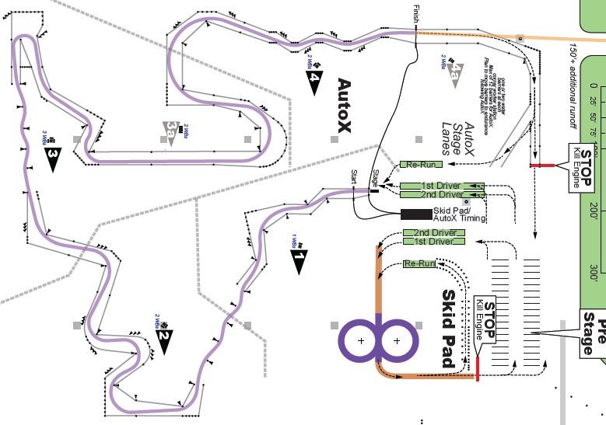
AUTOCROSS LAYOUT
Course is subject to change, Map is not to scale

Slide 23
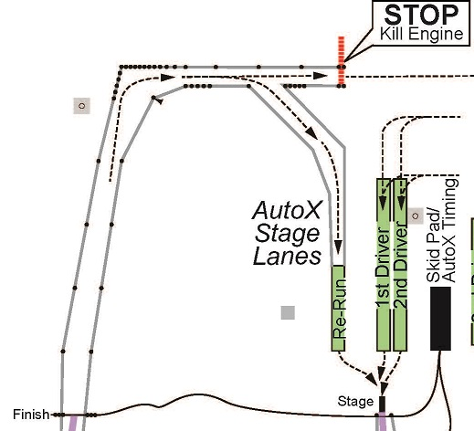
AUTOCROSS ENTRY/EXIT PROCEDURE

Slide 24
AUTOCROSS SCORING
Cone down and out = 2 second penalty
Off course = 20 second penalty
If you can safely enter course through same gate you left, there is no penalty
Missed Slalom is considered an off course
Cars that stall and cannot restart on course will be DNF for that lap – no rerun

Slide 25
ENDURANCE & FUEL EFFICIENCY
Saturday 8:30am - ~4:00pm
Captain: Lawrence Raitinger
Co-Captain: Jacob Homer

Slide 26
ENDURANCE EVENT - WEATHER
Teams are required to have the appropriate tire for weather condition at the start of their run
If the weather condition changes while a team is mid run, a tire change may be allowed or required
See below table for possible weather change scenarios
SCCA Safety Stewards can require immediate tire changes if conditions create an unsafe environment
Track Condition at start of run | Team's Current Tire Choice | Mid run Track Condition Change | Tire Change? | Additional Time Granted | Tire Change Allowed at Driver Change?
Dry | Dry | Damp | Optional | 10 minutes | Yes
Dry | Dry | Wet | Mandatory | 10 minutes | Yes
Damp | Dry | Wet | Mandatory | 10 minutes | Yes
Damp | Rain | Wet | --- | --- | ---
Damp | Dry | Dry | --- | --- | ---
Damp | Rain | Dry | Optional | zero | No
Wet | Rain | Damp | Optional | zero | No
Wet | Rain | Dry | Optional | zero | No

Slide 27
ENDURANCE RUN ORDER
The Run Order will be posted Friday evening once the Autocross event is over and preliminary scores processed
Only teams who have completed all four areas of tech by 5:00pm on Friday are eligible to participate in Endurance
Run order will be slowest to fastest Autocross times (including penalties) *EV cars will run separately
Teams who did not participate in any dynamic event prior to Endurance will run first at 9am
Lunch will begin at approximately 12:00pm, depending on cars on track
Teams scheduled immediately after lunch must keep their equipment in the dynamic area during lunch
Any team that runs out of order in Endurance will receive a 2 minute penalty

Slide 28
Fuel for the Event
The Announcer will call batches of teams to fuel their car based on run order
Endurance cars will be filled in the sequence of their scheduled run time
Process is similar to other fills. Car enters the fuel bay, driver removes fuel cap, confirms fuel type and fill line
Car is filled to bottom most part of the fill line. Driver confirms fill, installs fuel cap. NOTE – no vehicle shaking will be allowed before or after running endurance
Cars must proceed directly to Endurance after leaving Fuel area

Slide 29
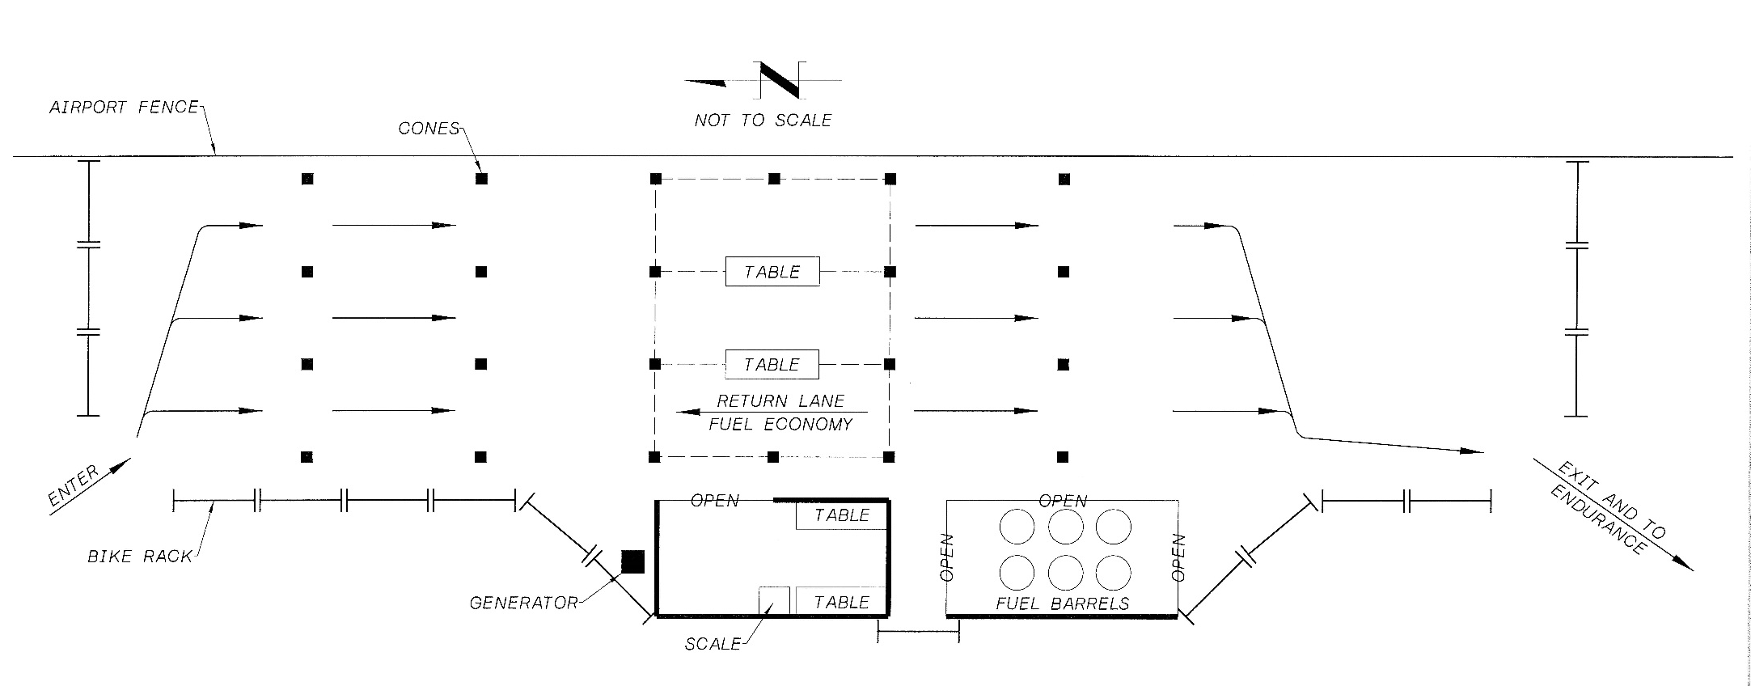
Fuel Layout

Slide 30
Arrive at the Dynamic Area
Dynamic Gate workers control how many teams are inside the hot area – you may have to wait outside the gate depending on event flow
Once inside the hot area you will be directed to a parking spot for your equipment
Toolboxes are allowed into dynamic area ONLY in the “parking area”
We suggest teams bring alternate tires if weather forecast is unclear
Teams may work on cars prior to starting endurance
Note all changes must be approved by Tech
Cars can be started anywhere in the dynamic area, BUT car CANNOT move under its own power until entering the track
People in pink vests are there to help direct you and answer questions

Slide 31
Stage for Start
Car must be “race ready” when called to staging
No external batteries, laptops, pressure gauges, baffles, tire wraps, etc.
Only the car, push-bar/fire extinguisher, anything for driver seating position adjustment during driver change and the team members is allowed
Team will be directed into one of the four staging lines
Transponder will be checked
Next team to go out on track will be called to the starting line
If this car cannot start or drive to the staging line, the next car will be called and the non-start car will receive the out of order penalty
If the non-start car is able to start/move before the car ahead of it goes on track, it will not receive the out of order penalty despite entering the track in the wrong order
Teams that cannot run at their designed time slot (due to no-start, etc) must run before the 20th run order after them in their heat (Ex: The team that is in the run order position 10 must run before run order position 30).
If fewer than 20 cars remain, we will provide a 15 minute window
Volunteers guide staging but are not required to give teams run time warning

Slide 32
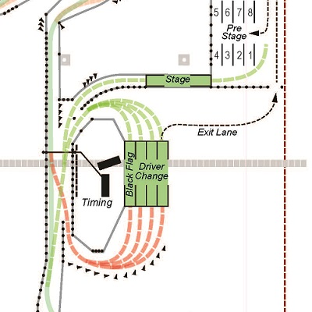
ENDURANCE ENTRY/EXIT PROCEDURE

Slide 33
Driver 1 Drives
Driver 1 is called to start: start the car and slowly drive to the green flagger
The other three team members should move away from the staging line
The green flagger waits for an opening on the track and then sends the car out for first 11km
Watch for flags – passing only allowed in passing zones
COURSE TO LEFT (inside lane), STAY RIGHT if blue-flagged
If you hit a barrier, you will be towed off the course and will not be permitted back on the track
For severe hits an Ambulance will be called to check the driver before they are allowed to exit the vehicle

Slide 34
Driver Change
At the end of his/her last lap Driver 1 will be shown a checkered flag to enter driver change
Driver change volunteers direct the car into the correct lane and the driver turns the car off
Each team has three minutes to swap drivers
Hand tools are only permitted to adjust seating position – car must start on its own (only tool allowance exception is for tire change due to weather)
Once Driver 2 is ready, driver starts their car and waits to be called to staging.

Slide 35
Driver 2 Drives
Driver 2 is called to staging and then to the start line
Staging workers will direct
The green flagger waits for an opening on the track and sends the car out
Driver 2 completes 11 km
Watch for flags – passing only allowed in passing zones
COURSE TO LEFT (inside lane), STAY RIGHT if blue-flagged
If you hit a barrier, you will be towed off the course and will not be permitted back on the track
For severe hits an Ambulance will be called to check the driver before they are allowed to exit the vehicle

Slide 36
Finishing the Event
On the last lap the driver is shown a checkered flag and exits
As soon as the exit is cleared, shut down the car and stop. Do not drive (or coast) to team equipment area
Hooray! You just completed Endurance
Gather your team and equipment and head to the dynamic gate for instructions to proceed to fuel

Slide 37
Refuel for Efficiency Points
Cars that did not complete endurance still need to report to fuel for points for Efficiency score
Car returns directly to fuel bay
Driver exits car, hoists a full gas can with the appropriate fuel grade, and is escorted to obtain the initial can weight
Driver returns the can to the car, removes the fuel cap, confirms fuel type and fill line.
Car is filled to bottom-most part of line. Driver confirms fill and installs fuel cap.
Driver returns to the scale, carrying the gas can. The new can weight is registered, along with the driver signature, which defines the correct and accurate Fuel Efficiency score.

Slide 38
Scoring Notes
Cone down and out = 2 second penalty
Off course = 20 second penalty
If you can safely enter course through same (or prior) gate you exited, there is no penalty
The Endurance penalties are not assigned to the lap that they were received. There will be a total number of cones and off courses listed for teams for the event.
No outside data for protests – video footage, data logging, etc. Event captain does not have time to review entire endurance run video for every team.
Endurance Tmax rule gives the ability to pull a team out of the event, but is not a requirement that we do so
We will never pull a team without a warning – the team will be black flagged and offered the chance to correct

Slide 39
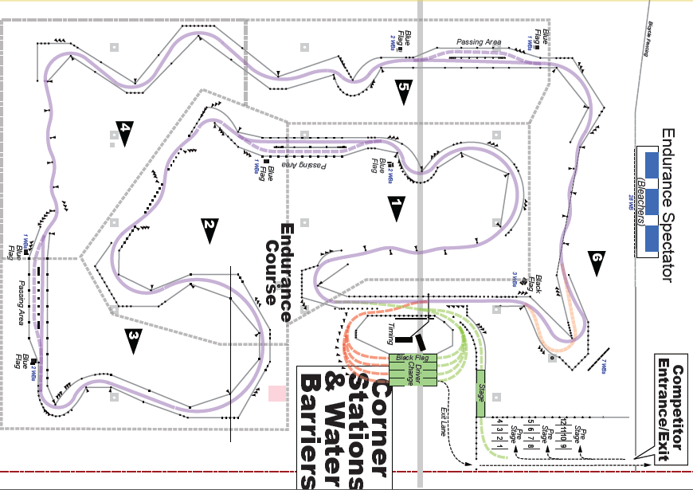
ENDURANCE LAYOUT
Course is subject to change, Map is not to scale

Slide 40
Endurance Red Flag Protocol
Safely bring vehicle to a complete stop
Everyone will be towed into the driver change area
Driver must stay fully belted in car
The lap in which the red flag was shown will not count in time or fuel economy calculations
Restart rules are the same as driver change
Teams involved with a red flagged track will not be able to add any fuel to their vehicle

Slide 41
Black Flag Protocol
Exit the track on the lap you see the black flag – do not go another lap
You will be guided into the black flag penalty box located next to driver change
The Black Flag Marshall will talk to you about why you were brought in
If you are assessed a time penalty, it will happen at this time.
The driver has the choice to leave the car running or not during this penalty – driver change restart rules apply
The clock is still running while you are off the course
You will be released onto track once the time is up with the guidance of the staging workers

Slide 42
Mechanical Flag Protocol
Exit the track on the lap you see the mechanical flag (or meatball) – do not go a second lap
You will be directed into a lane in the driver change area and your car will be inspected by Tech
The time off course will not count towards your overall time
If the issue is deemed OK, you will be released back on track with the guidance of the staging worker
If the issue is deemed a failure, the team will be disqualified and will not be able to complete the event

Slide 43
QUESTIONS?
Event Captains are available for questions right after this meeting.
Please clarify any unclear rules/directions at this time.

